Slide 1
Linear Algebra 101 somewhat

Slide 2
Contents
Basic stuff to know about matrices
System of linear equations
Basic stuff to know about vectors/vector space
Eigen values/vectors
Orthogonal
Matrix factorization
PCA

Slide 3
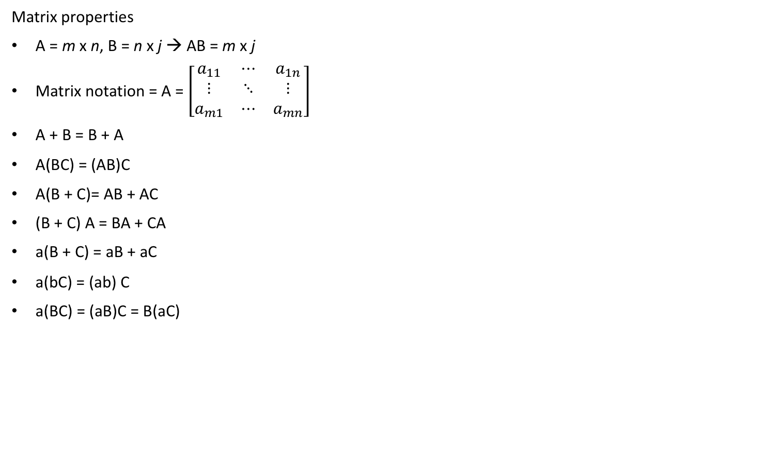
Basic stuff to know about matrices
Matrix properties
A = m x n, B = n x j → AB = m x j
Matrix notation = A = $\left[\begin{matrix}a_{11} & ⋯ & a_{1n} \\ ⋮ & ⋱ & ⋮ \\ a_{m1} & ⋯ & a_{mn}\end{matrix}\right]$
A + B = B + A
A(BC) = (AB)C
A(B + C)= AB + AC
(B + C) A = BA + CA
a(B + C) = aB + aC
a(bC) = (ab) C
a(BC) = (aB)C = B(aC)

Slide 4
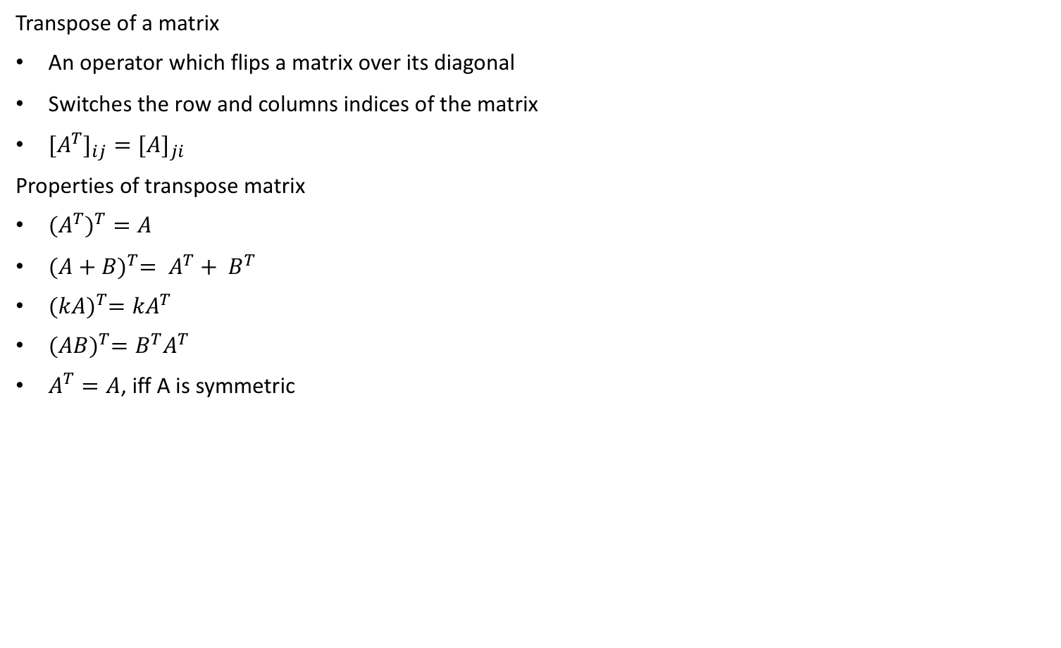
Basic stuff to know about matrices
Transpose of a matrix
An operator which flips a matrix over its diagonal
Switches the row and columns indices of the matrix
${{[A}^{T}]}_{ij}={[A]}_{ji}$
Properties of transpose matrix
${{(A}^{T})}^{T}=A$
${(A+B)}^{T}= A^{T}+ B^{T}$
${(kA)}^{T}={kA}^{T}$
${(AB)}^{T}=B^{T}A^{T}$
$A^{T}=A$, iff A is symmetric

Slide 5
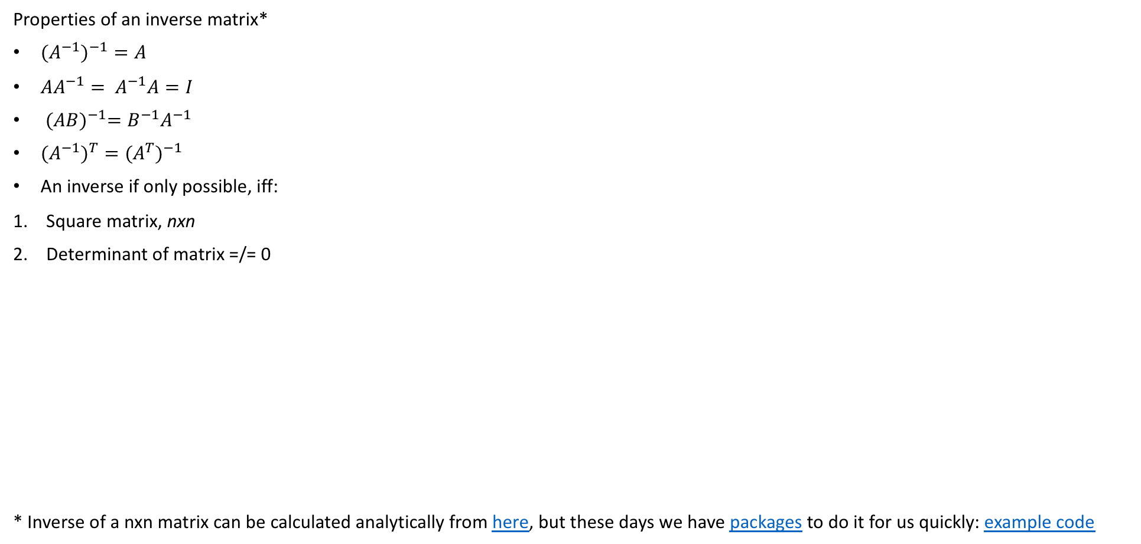
Basic stuff to know about matrices
Properties of an inverse matrix*
${{(A}^{−1})}^{−1}=A$
${AA}^{−1}= A^{−1}A=I$
${(AB)}^{−1}={B^{−1}A}^{−1}$
${{(A}^{−1})}^{T}={{(A}^{T})}^{−1}$
An inverse if only possible, iff:
Square matrix, nxn
Determinant of matrix =/= 0
* Inverse of a nxn matrix can be calculated analytically from here, but these days we have packages to do it for us quickly: example code

Slide 6
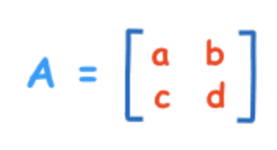
Basic stuff to know
What is determinant?
It is the scaling factor of the linear transformation described by the matrix
I will only refresh the idea of determinant from a 2x2 matrix
It doesn’t value add to know how to calculate determinant beyond a 2x2 square matrix*
|A| = a * d – b * c
* Link to calculation of determinant beyond 2x2 matrix: here

Slide 7
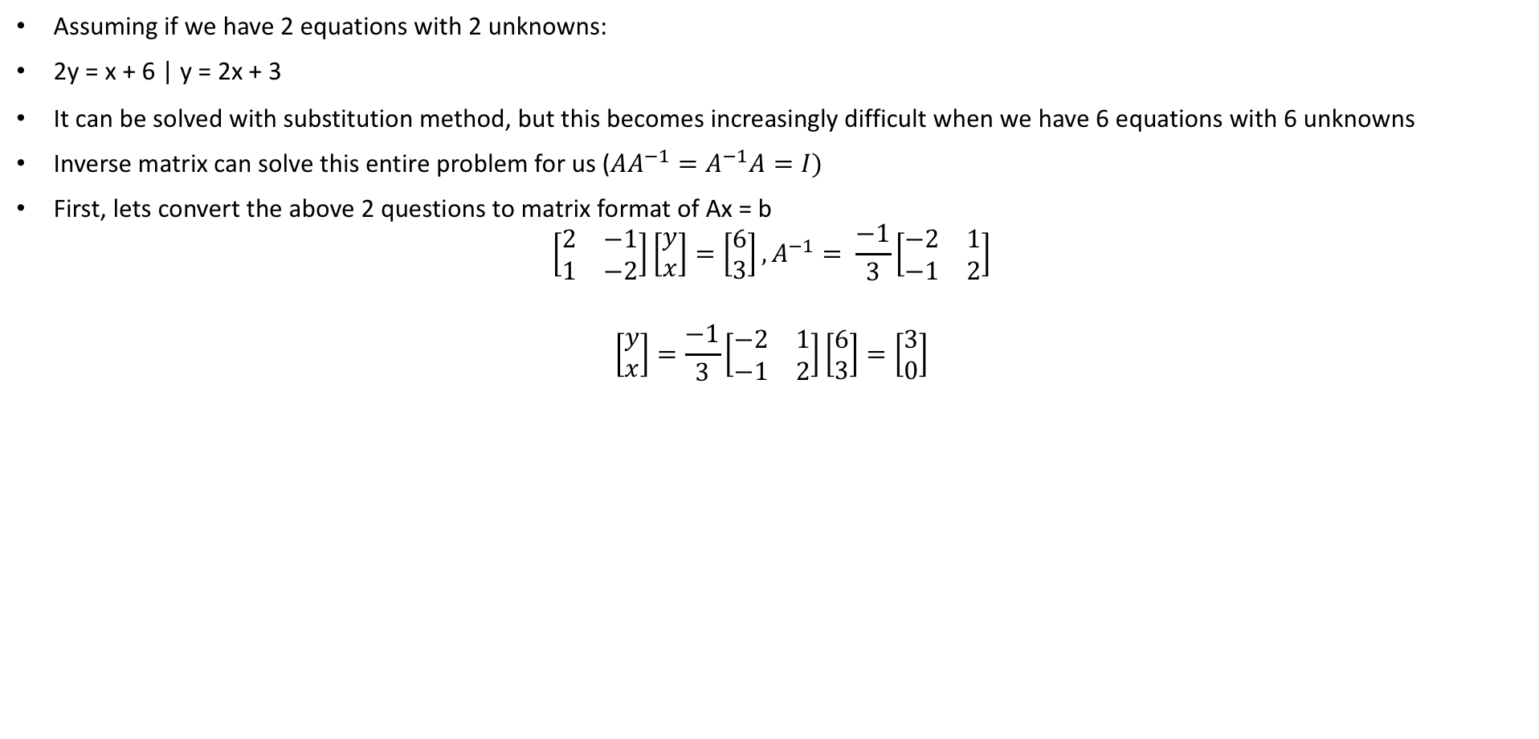
System of linear equations
Assuming if we have 2 equations with 2 unknowns:
2y = x + 6 | y = 2x + 3
It can be solved with substitution method, but this becomes increasingly difficult when we have 6 equations with 6 unknowns
Inverse matrix can solve this entire problem for us (${AA}^{−1}=A^{−1}A=I)$
First, lets convert the above 2 questions to matrix format of Ax = b
$$\left[\begin{matrix}2 & −1 \\ 1 & −2\end{matrix}\right]\left[\begin{aligned}y \\ x\end{aligned}\right]=\left[\begin{aligned}6 \\ 3\end{aligned}\right],A^{−1}= \frac{−1}{3}\left[\begin{matrix}−2 & 1 \\ −1 & 2\end{matrix}\right]$$
$$\left[\begin{aligned}y \\ x\end{aligned}\right]=\frac{−1}{3}\left[\begin{matrix}−2 & 1 \\ −1 & 2\end{matrix}\right]\left[\begin{aligned}6 \\ 3\end{aligned}\right]=\left[\begin{aligned}3 \\ 0\end{aligned}\right]$$

Slide 8
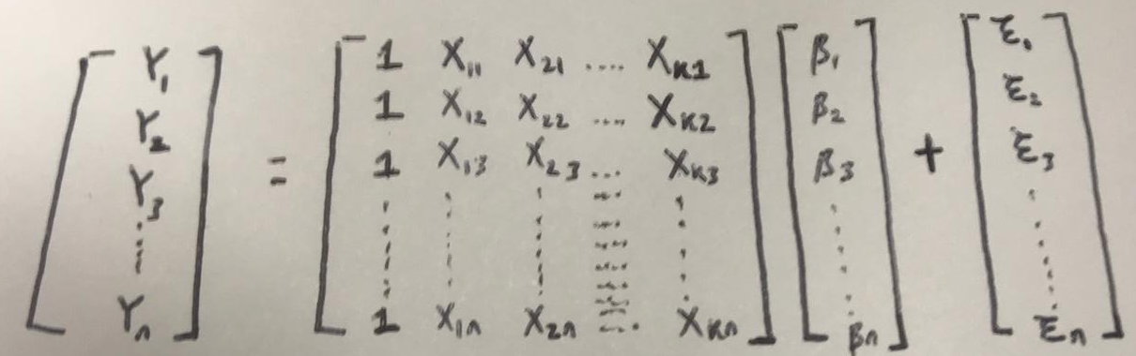
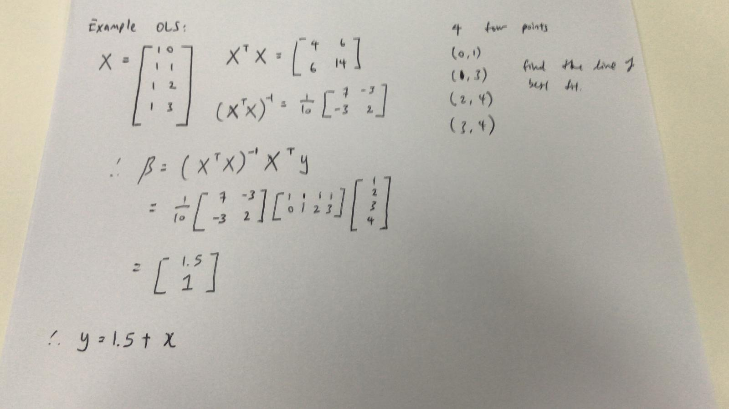
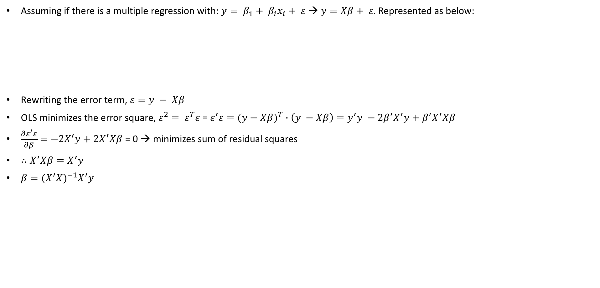
Using system of linear equations for OLS
Assuming if there is a multiple regression with: $y= β_{1}+ β_{i}x_{i}+ ε$ → $y=Xβ+ ε.$ Represented as below:
Rewriting the error term, $ε=y − Xβ$
OLS minimizes the error square, $ε^{2}= ε^{T}ε$ = $ε^{′}ε={(y−Xβ)}^{T} ∙\left(y −Xβ\right)=y^{′}y −2β^{′}X^{′}y+β^{′}X^{′}Xβ$
$\frac{∂ε^{′}ε}{∂β}=−2X^{′}y+2X^{′}Xβ$ = 0 → minimizes sum of residual squares
$∴X^{′}Xβ=X^{′}y$
$β={(X^{′}X)}^{−1}X^{′}y$

Slide 9
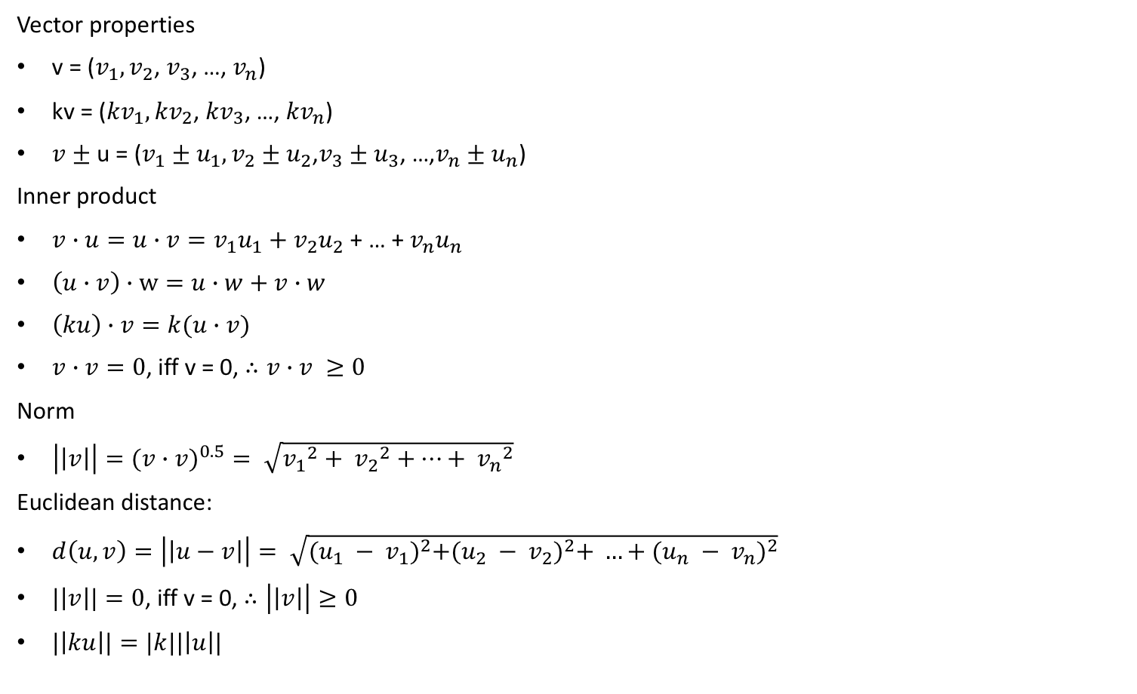
Basic stuff to know about vectors/spaces
Vector properties
v = ($v_{1},v_{2}$, $v_{3}$, …, $v_{n}$)
kv = (${kv}_{1},{kv}_{2}$, ${kv}_{3}$, …, ${kv}_{n}$)
$v$ $±$ u = ($v_{1}±u_{1},v_{2}±u_{2}$,$v_{3}±u_{3}$, …,$v_{n}±u_{n}$)
Inner product
$v∙u=u∙v=v_{1}u_{1}+v_{2}u_{2}$ + … + $v_{n}u_{n}$
$\left(u∙v\right)∙w=u∙w+v∙w$
$\left(ku\right)∙v=k(u∙v)$
$v∙v=0$, iff v = 0, $∴v∙v ≥0$
Norm
$\left|\left|v\right|\right|=(v∙{v)}^{0.5}= \sqrt{{v_{1}}^{2}+ {v_{2}}^{2}+…+ {v_{n}}^{2}}$
Euclidean distance:
$d\left(u,v\right)=\left|\left|u−v\right|\right|= \sqrt{{(u_{1} − v_{1})}^{2}+{(u_{2} − v_{2})}^{2}+ …+{(u_{n} − v_{n})}^{2}}$
$|\left|v\right||=0$, iff v = 0, $∴\left|\left|v\right|\right|≥0$
$|\left|ku\right||=|k||\left|u\right||$

Slide 10
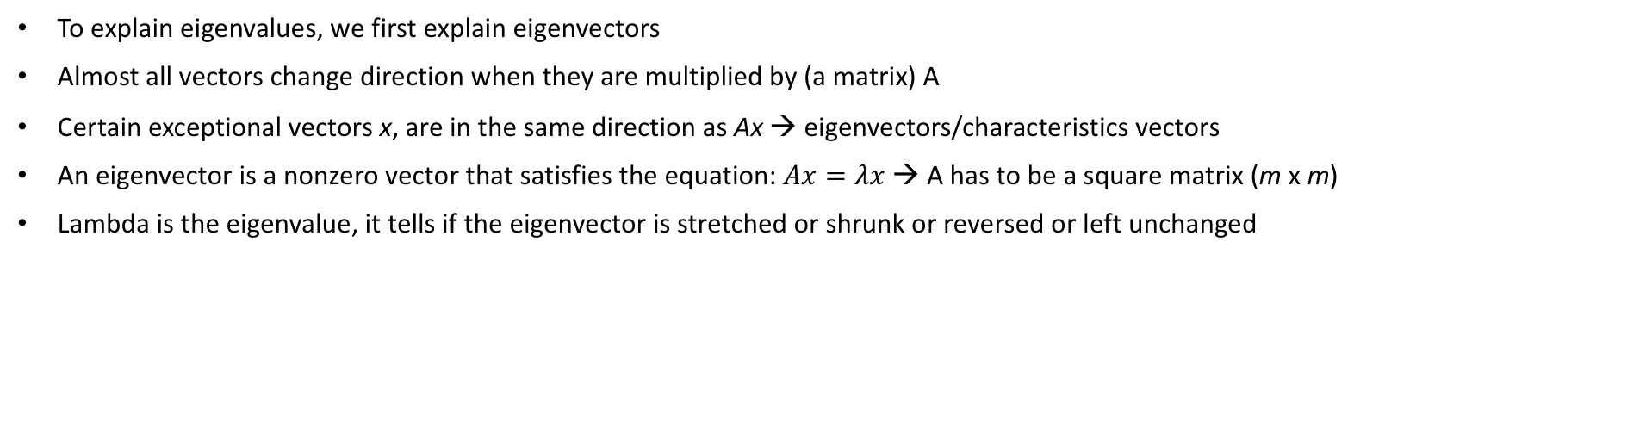
Eigen values/vectors
To explain eigenvalues, we first explain eigenvectors
Almost all vectors change direction when they are multiplied by (a matrix) A
Certain exceptional vectors x, are in the same direction as Ax → eigenvectors/characteristics vectors
An eigenvector is a nonzero vector that satisfies the equation: $Ax=λx$ → A has to be a square matrix (m x m)
Lambda is the eigenvalue, it tells if the eigenvector is stretched or shrunk or reversed or left unchanged

Slide 11
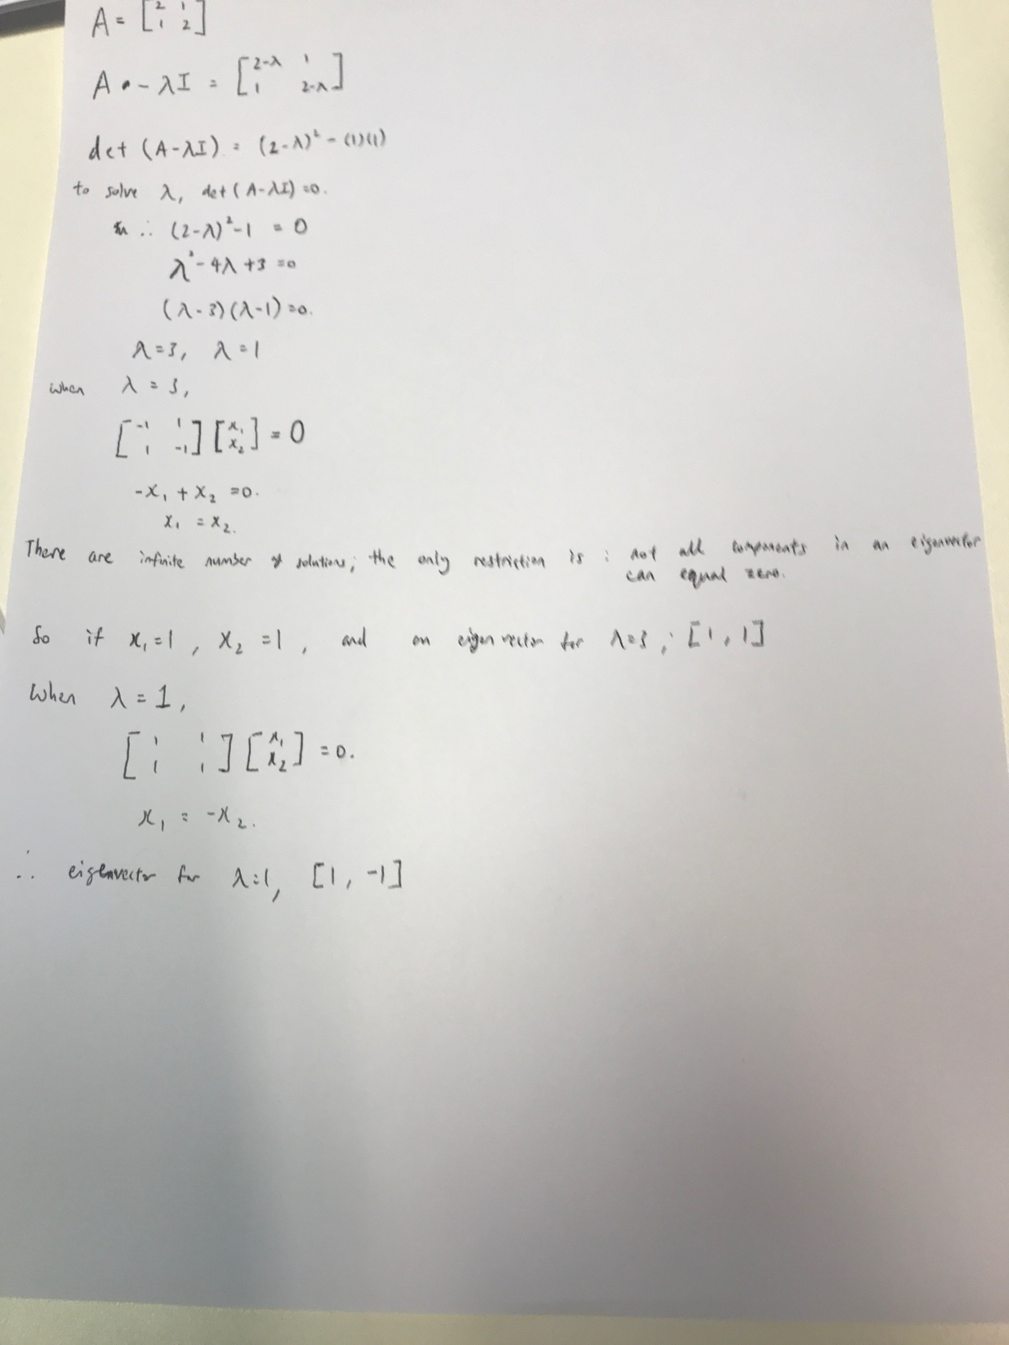

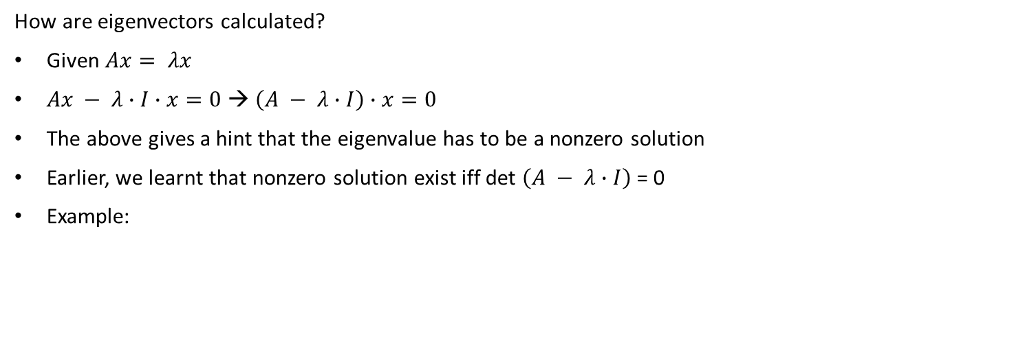
Eigen values/vectors
How are eigenvectors calculated?
Given $Ax= λx$
$Ax − λ∙I∙x=0$ → $\left(A − λ∙I\right)∙x=0$
The above gives a hint that the eigenvalue has to be a nonzero solution
Earlier, we learnt that nonzero solution exist iff det $\left(A − λ∙I\right)$ = 0
Example:

Slide 12
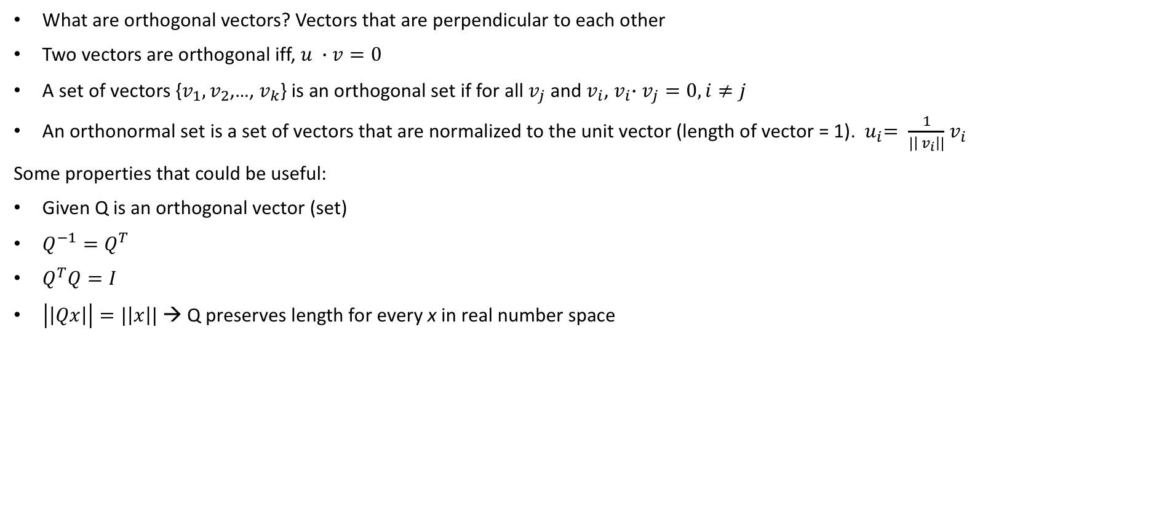
Orthogonal vectors
What are orthogonal vectors? Vectors that are perpendicular to each other
Two vectors are orthogonal iff, $u ∙v=0$
A set of vectors {$v_{1},v_{2}$,…, $v_{k}$} is an orthogonal set if for all $v_{j}$ and $v_{i}$,${ v}_{i}∙v_{j}=0, i≠j$
An orthonormal set is a set of vectors that are normalized to the unit vector (length of vector = 1). ${ u}_{i}= \frac{1}{|\left|{ v}_{i}\right||}{ v}_{i}$
Some properties that could be useful:
Given Q is an orthogonal vector (set)
$Q^{−1}=Q^{T}$
$Q^{T}Q=I$
$\left|\left|Qx\right|\right|=|\left|x\right||$ → Q preserves length for every x in real number space

Slide 13
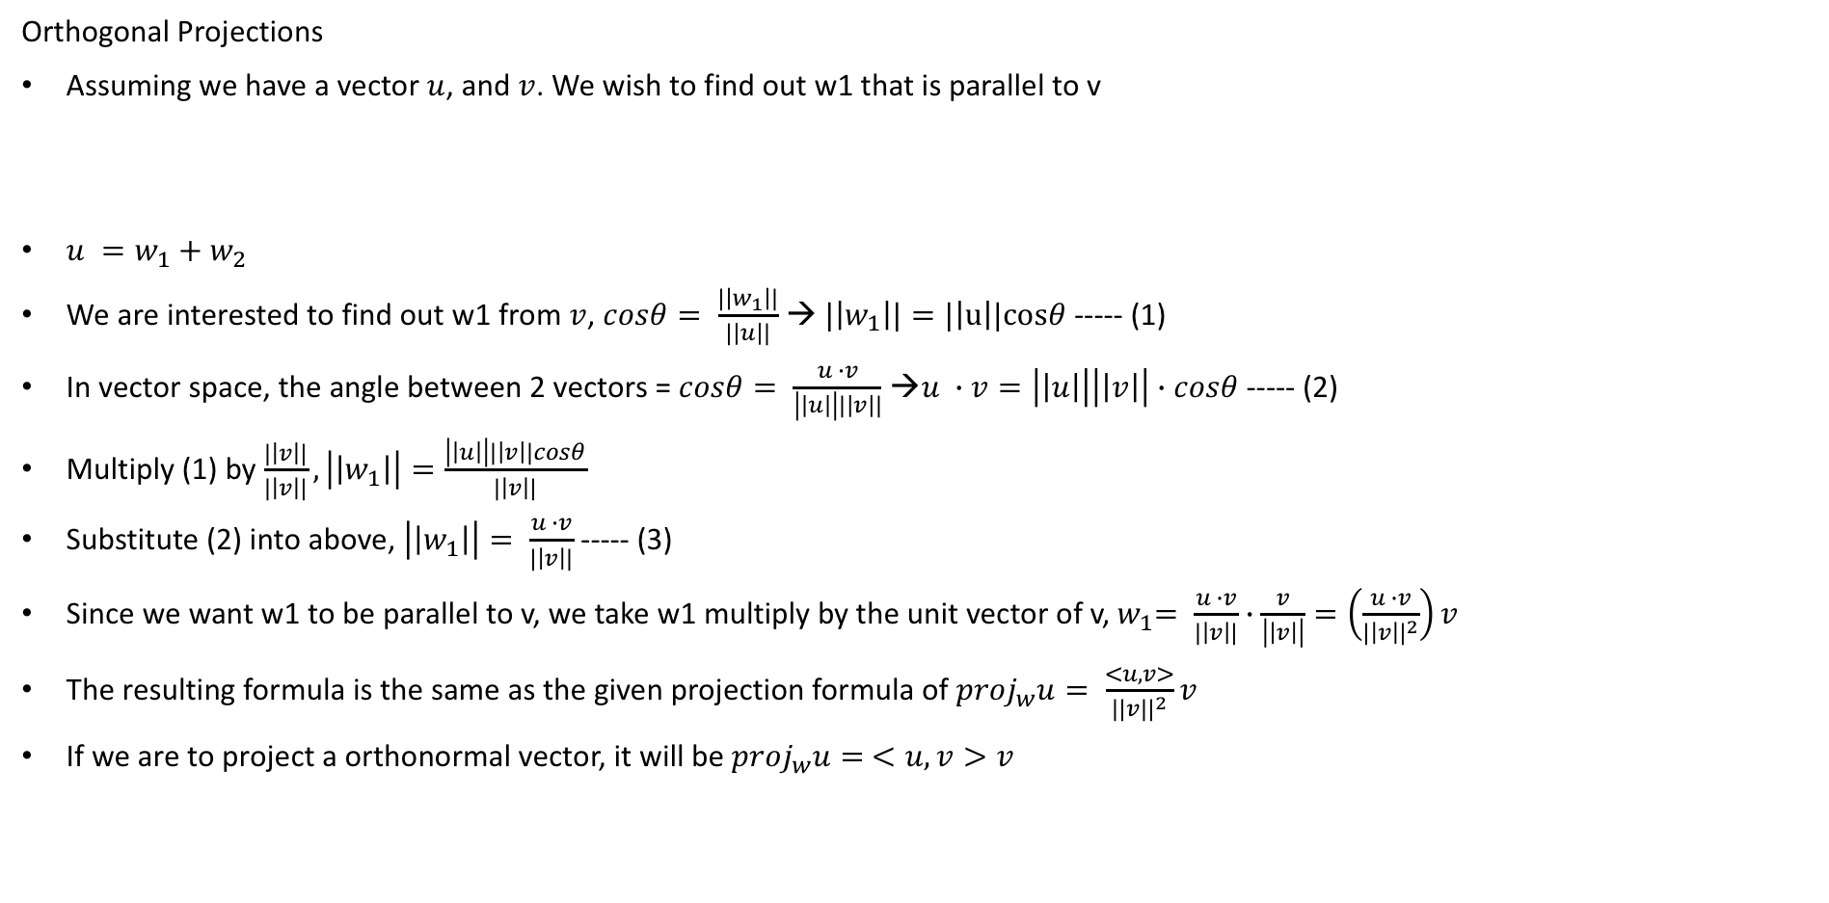
Orthogonal Projections
Orthogonal Projections
Assuming we have a vector $u$, and $v$. We wish to find out w1 that is parallel to v
$u =w_{1}+w_{2}$
We are interested to find out w1 from $v$, $cosθ= \frac{|\left|w_{1}\right||}{|\left|u\right||}$ → $|\left|w_{1}\right||=|\left|u\right||cosθ$ ----- (1)
In vector space, the angle between 2 vectors = $cosθ= \frac{u ∙v}{\left|\left|u\right|\right||\left|v\right||}$ →$u ∙v=\left|\left|u\right|\right|\left|\left|v\right|\right|∙cosθ$----- (2)
Multiply (1) by $\frac{|\left|v\right||}{|\left|v\right||}, \left|\left|w_{1}\right|\right|=\frac{\left|\left|u\right|\right||\left|v\right||cosθ}{|\left|v\right||}$
Substitute (2) into above, $\left|\left|w_{1}\right|\right|= \frac{u ∙v}{|\left|v\right||}$ ----- (3)
Since we want w1 to be parallel to v, we take w1 multiply by the unit vector of v,${ w}_{1}= \frac{u ∙v}{|\left|v\right||}∙\frac{v}{\left|\left|v\right|\right|}=\left(\frac{u ∙v}{{|\left|v\right||}^{2}}\right)v$
The resulting formula is the same as the given projection formula of ${proj}_{w}u= \frac{<u,v>}{||v{||}^{2}}v$
If we are to project a orthonormal vector, it will be ${proj}_{w}u= <u,v>v$
u
w2
w1
v

Slide 14
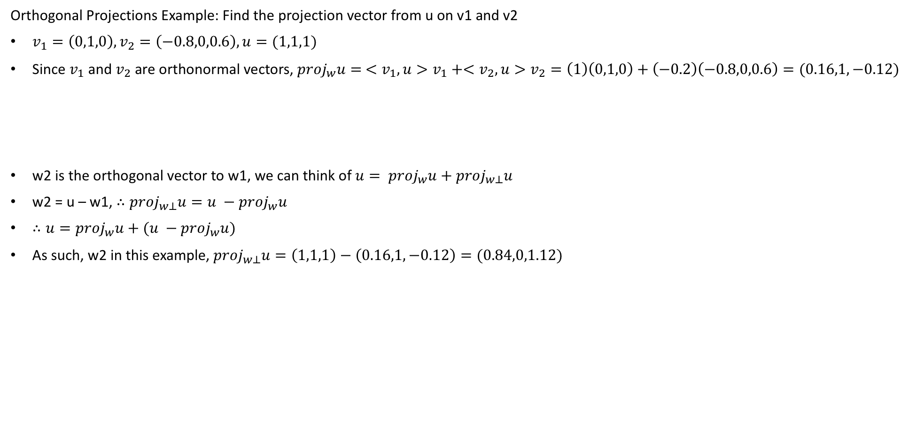
Orthogonal vectors
Orthogonal Projections Example: Find the projection vector from u on v1 and v2
$v_{1}=\left(0,1,0\right),v_{2}=\left(−0.8,0,0.6\right), u=(1,1,1)$
Since $v_{1}$ and $v_{2}$ are orthonormal vectors, ${proj}_{w}u= <v_{1},u>v_{1}+<v_{2},u>v_{2}=\left(1\right)\left(0,1,0\right)+\left(−0.2\right)\left(−0.8,0,0.6\right)=(0.16,1,−0.12)$
w2 is the orthogonal vector to w1, we can think of $u= {proj}_{w}u+{proj}_{w⊥}u$
w2 = u – w1, $∴{proj}_{w⊥}u=u −{proj}_{w}u$
$∴u={proj}_{w}u+(u −{proj}_{w}u)$
As such, w2 in this example, ${proj}_{w⊥}u=\left(1,1,1\right)−\left(0.16,1,−0.12\right)=(0.84,0,1.12)$
u
w2
w1
v

Slide 15
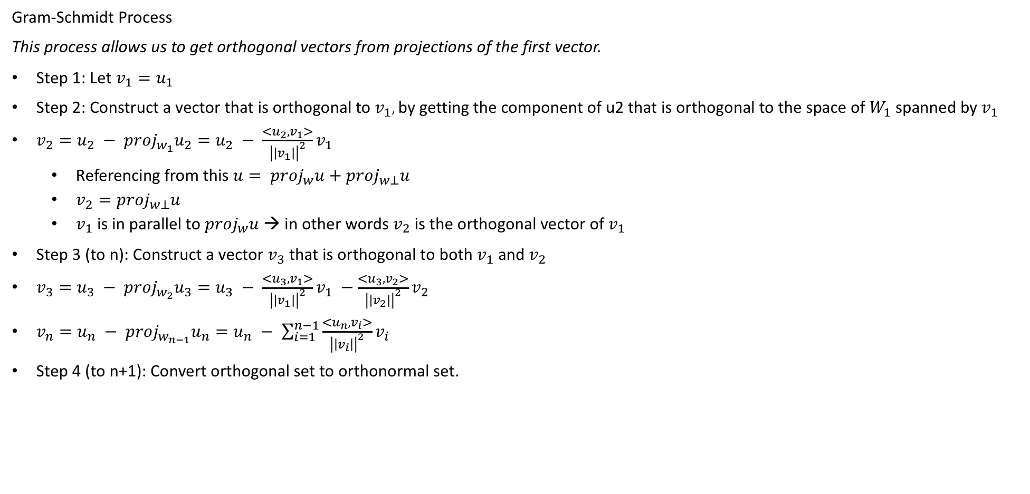
Orthogonal vectors
Gram-Schmidt Process
This process allows us to get orthogonal vectors from projections of the first vector.
Step 1: Let $v_{1}=u_{1}$
Step 2: Construct a vector that is orthogonal to $v_{1}$, by getting the component of u2 that is orthogonal to the space of $W_{1}$ spanned by $v_{1}$
$v_{2}=u_{2} − {proj}_{w_{1}}u_{2}=u_{2} − \frac{<u_{2},v_{1}>}{{\left|\left|v_{1}\right|\right|}^{2}}v_{1}$
Referencing from this $u= {proj}_{w}u+{proj}_{w⊥}u$
$v_{2}={proj}_{w⊥}u$
$v_{1}$ is in parallel to ${proj}_{w}u$ → in other words $v_{2}$ is the orthogonal vector of $v_{1}$
Step 3 (to n): Construct a vector $v_{3}$ that is orthogonal to both $v_{1}$ and $v_{2}$
$v_{3}=u_{3} − {proj}_{w_{2}}u_{3}=u_{3} − \frac{<u_{3},v_{1}>}{{\left|\left|v_{1}\right|\right|}^{2}}v_{1} −\frac{<u_{3},v_{2}>}{{\left|\left|v_{2}\right|\right|}^{2}}v_{2}$
$v_{n}=u_{n} − {proj}_{w_{n−1}}u_{n}=u_{n} − \sum_{i=1}^{n−1}{\frac{<u_{n},v_{i}>}{{\left|\left|v_{i}\right|\right|}^{2}}v_{i}}$
Step 4 (to n+1): Convert orthogonal set to orthonormal set.

Slide 16
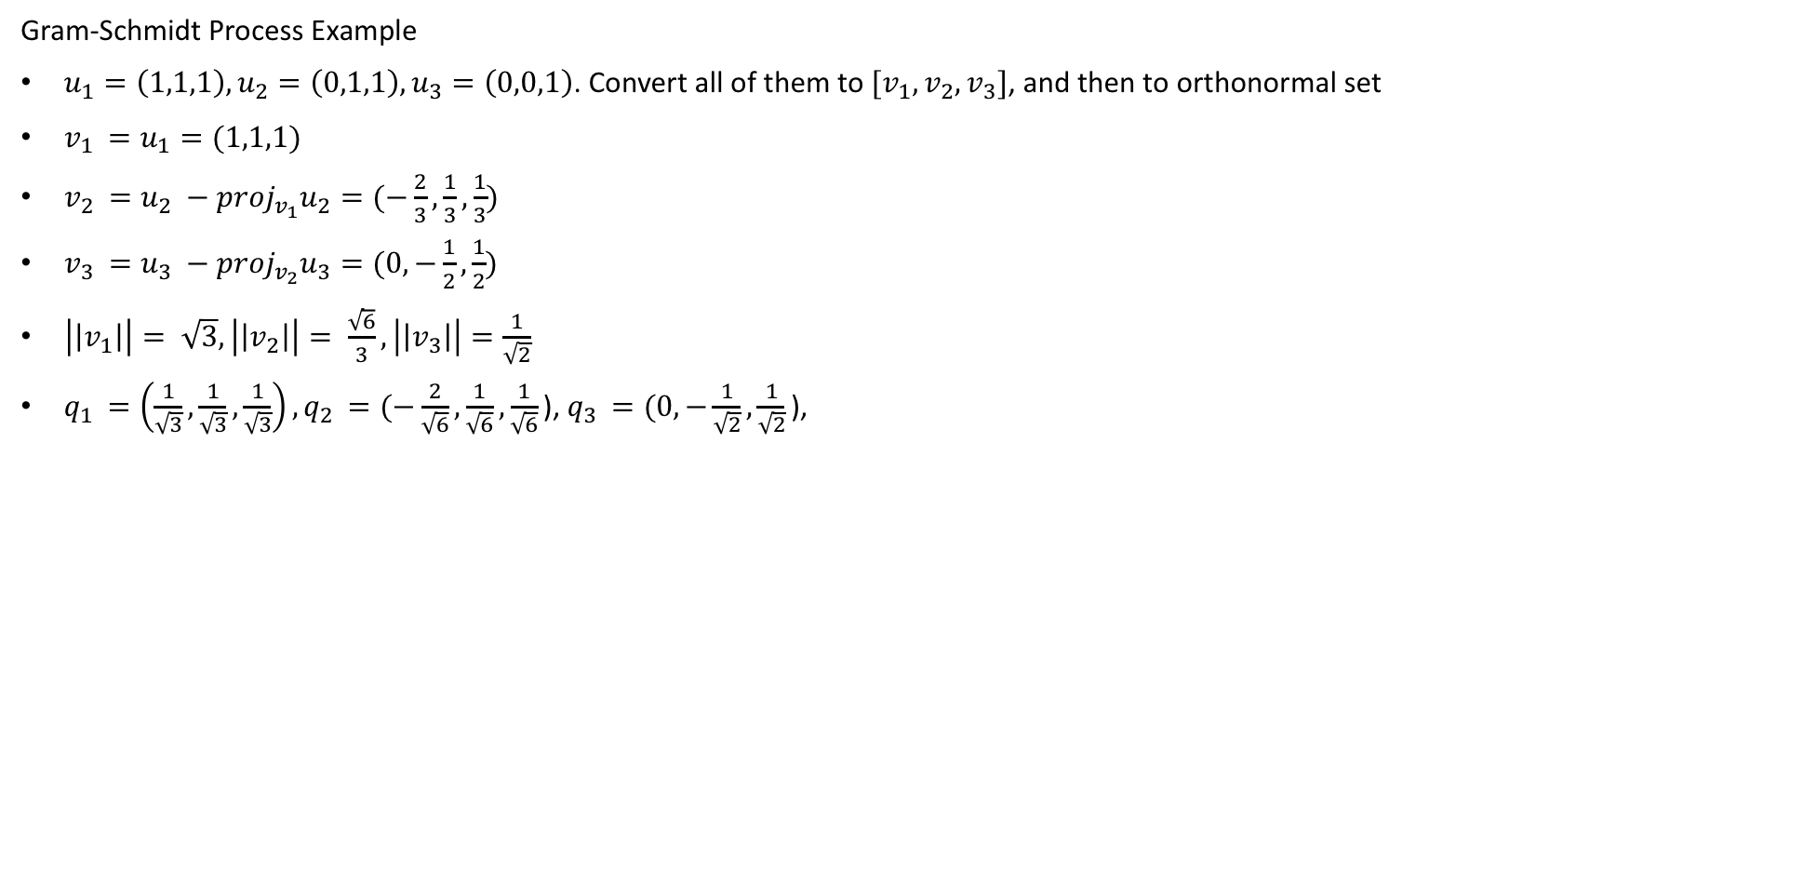
Orthogonal vectors
Gram-Schmidt Process Example
$u_{1}=\left(1,1,1\right),u_{2}=\left(0,1,1\right),u_{3}=\left(0,0,1\right)$. Convert all of them to ${[v}_{1},v_{2},v_{3}]$, and then to orthonormal set
$v_{1 }=u_{1}=(1,1,1)$
$v_{2 }=u_{2} −{proj}_{v_{1}}u_{2}=(−\frac{2}{3},\frac{1}{3},\frac{1}{3})$
$v_{3 }=u_{3} −{proj}_{v_{2}}u_{3}=(0,−\frac{1}{2},\frac{1}{2})$
$\left|\left|v_{1}\right|\right|= \sqrt{3},\left|\left|v_{2}\right|\right|= \frac{\sqrt{6}}{3},\left|\left|v_{3}\right|\right|=\frac{1}{\sqrt{2}}$
$q_{1 }=\left(\frac{1}{\sqrt{3}},\frac{1}{\sqrt{3}},\frac{1}{\sqrt{3}}\right),q_{2 }=(−\frac{2}{\sqrt{6}},\frac{1}{\sqrt{6}},\frac{1}{\sqrt{6}}\text{),}{ q}_{3 }=(0,−\frac{1}{\sqrt{2}},\frac{1}{\sqrt{2}}\text{), }$

Slide 17
Matrix Factorization
QR decomposition
LU decomposition
Singular value decomposition

Slide 18
Matrix Factorization
Singular value decomposition (SVD)
The others will be revisited after PCA, SVD is used in PCA, hence easier to draw relevance if explained first
The main usage of SVD are:
Reduce dimension
Exposes substructure of data → tell us which variables are correlated, and high variance
Used in recommendation system and NLP

Slide 19
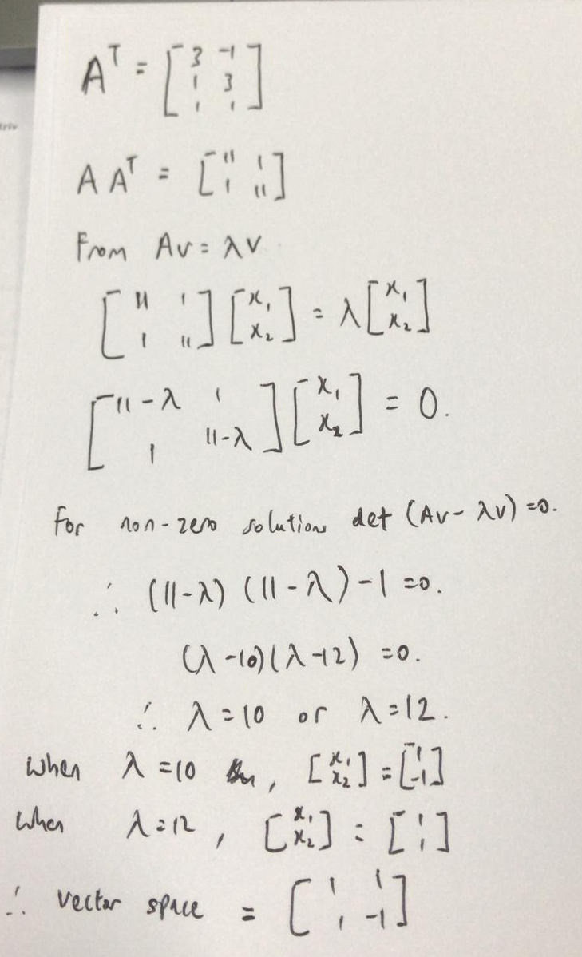
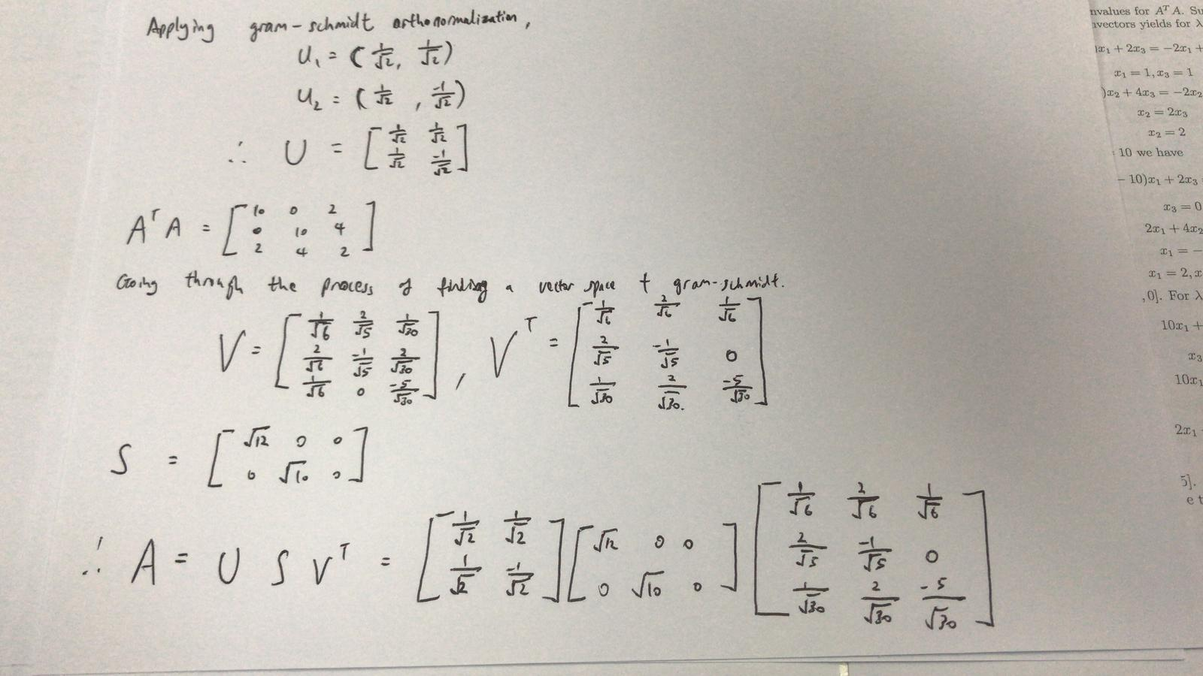
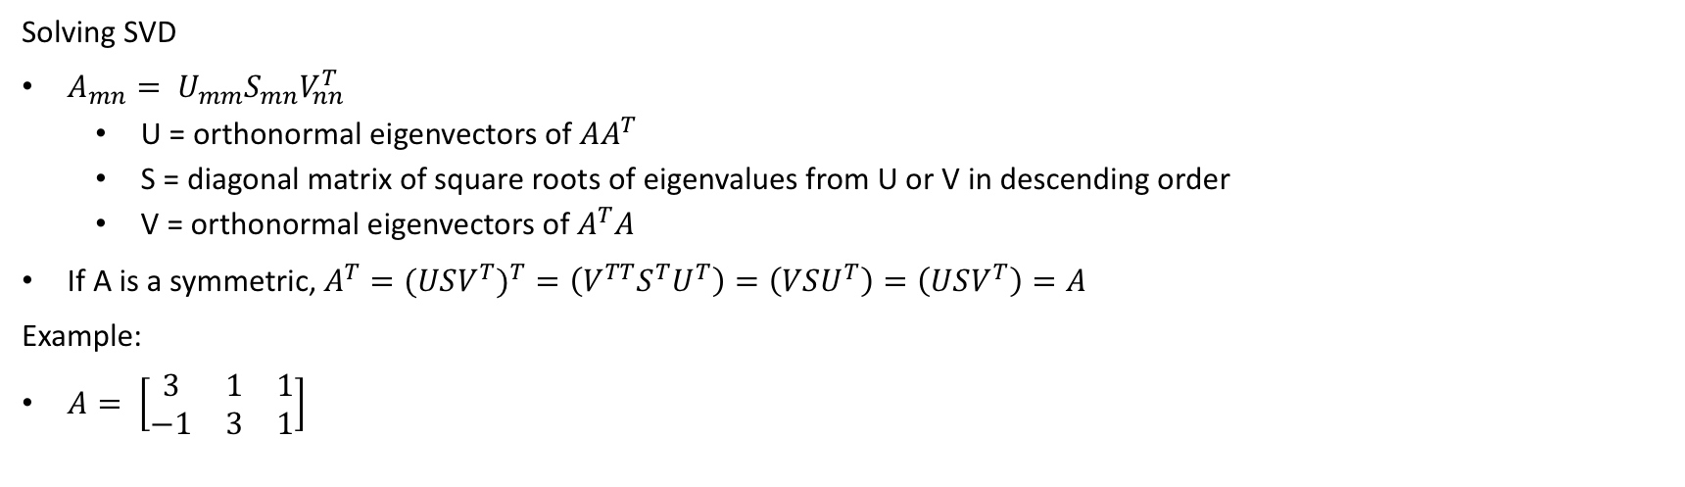
Singular Value Decomposition (SVD)
Solving SVD
$A_{mn}= U_{mm}S_{mn}V_{nn}^{T}$
U = orthonormal eigenvectors of $AA^{T}$
S = diagonal matrix of square roots of eigenvalues from U or V in descending order
V = orthonormal eigenvectors of $A^{T}A$
If A is a symmetric, $A^{T}=(USV^{T})^{T}=\left(V^{TT}S^{T}U^{T}\right)=\left(VSU^{T}\right)=\left(USV^{T}\right)=A$
Example:
$A= \left[\begin{matrix}3 & 1 & 1 \\ −1 & 3 & 1\end{matrix}\right]$

Slide 20
Principal Component Analysis
Goal: compute the most meaningful basis to re-express, a noisy dataset. The new basis will filter out the noise and reveal hidden dynamics
It helps to
Reduce dimension
Extract relevant information from datasets

Slide 21
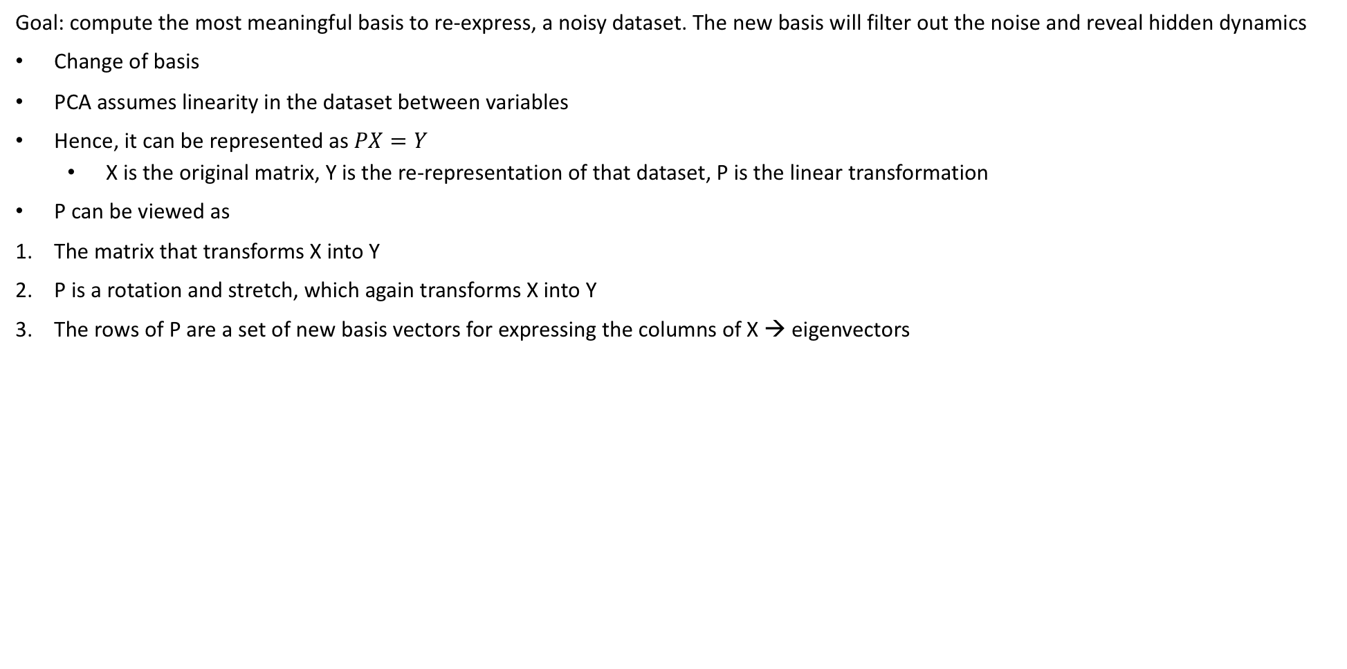
Principal Component Analysis
Goal: compute the most meaningful basis to re-express, a noisy dataset. The new basis will filter out the noise and reveal hidden dynamics
Change of basis
PCA assumes linearity in the dataset between variables
Hence, it can be represented as $PX=Y$
X is the original matrix, Y is the re-representation of that dataset, P is the linear transformation
P can be viewed as
The matrix that transforms X into Y
P is a rotation and stretch, which again transforms X into Y
The rows of P are a set of new basis vectors for expressing the columns of X → eigenvectors

Slide 22
Principal Component Analysis
Variance and goal
The best ways to interpret noisy dataset are
Noise
Redundancy

Slide 23
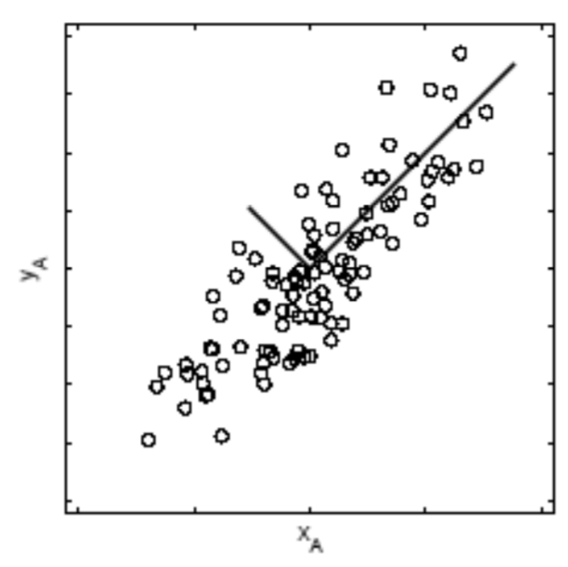
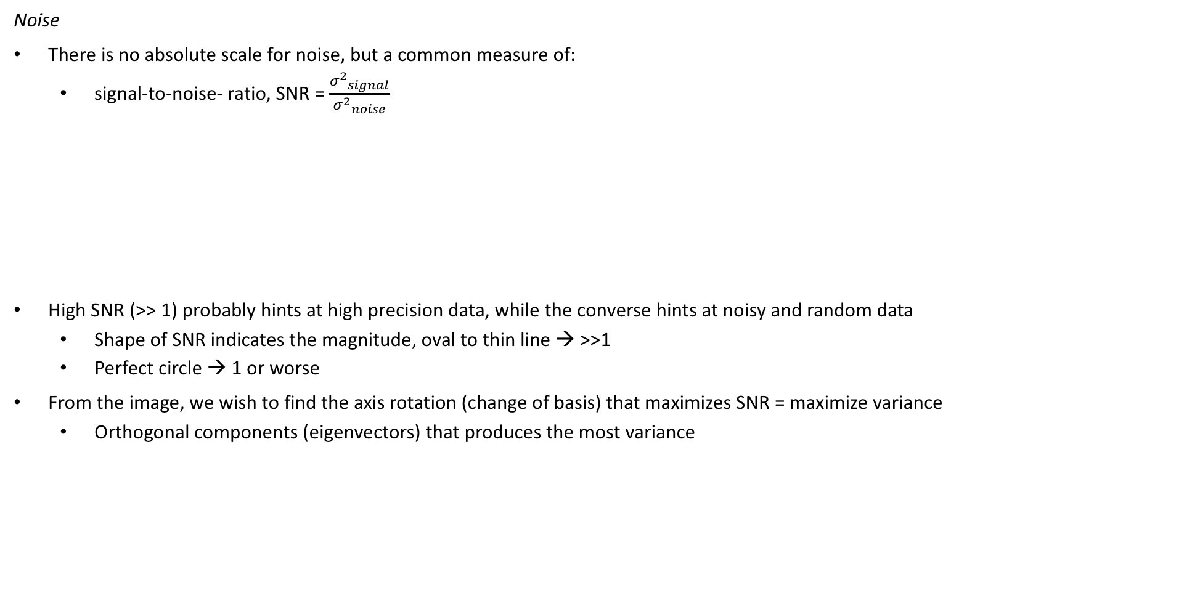
Principal Component Analysis
Noise
There is no absolute scale for noise, but a common measure of:
signal-to-noise- ratio, SNR = $\frac{{σ^{2}}_{signal}}{{σ^{2}}_{noise}}$
High SNR (>> 1) probably hints at high precision data, while the converse hints at noisy and random data
Shape of SNR indicates the magnitude, oval to thin line → >>1
Perfect circle → 1 or worse
From the image, we wish to find the axis rotation (change of basis) that maximizes SNR = maximize variance
Orthogonal components (eigenvectors) that produces the most variance
signal
noise

Slide 24
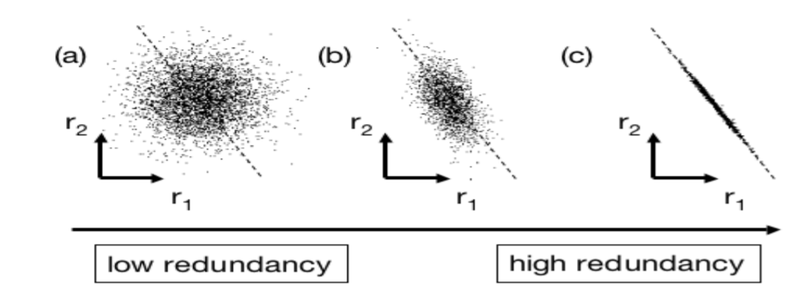
Principal Component Analysis
Redundancy
Panel (a) depicts 2 variables with no redundancy (no correlation)
Panel (c) suggests strong correlation
Shows good intuition of dimension reduction, having only r2 or r1 would be sufficient
Reducing from 2 to 1 variable
Ideally we would want variables to have little or no correlation in panel (a) → reducing multi-collinearity (and maximizing variance)

Slide 25
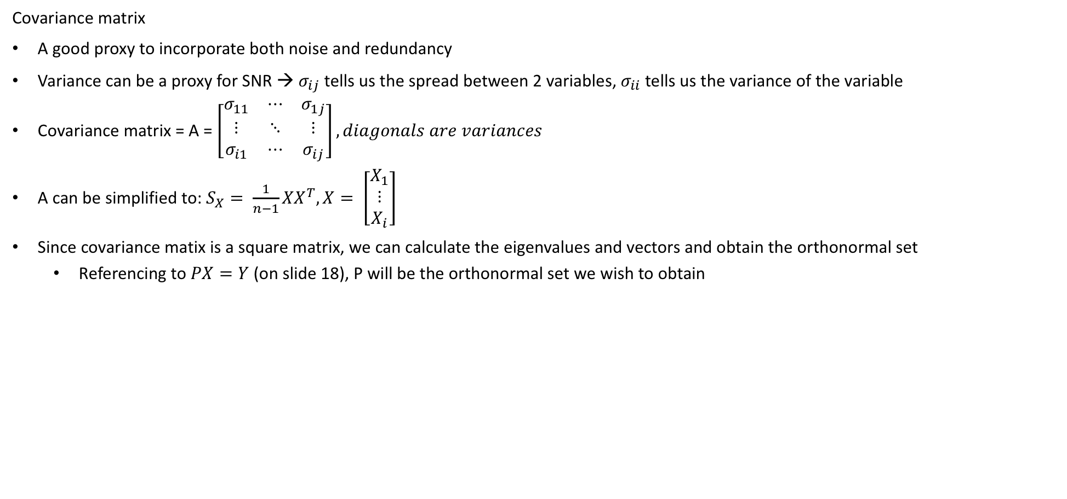
Principal Component Analysis
Covariance matrix
A good proxy to incorporate both noise and redundancy
Variance can be a proxy for SNR → $σ_{ij}$ tells us the spread between 2 variables, $σ_{ii}$ tells us the variance of the variable
Covariance matrix = A = $\left[\begin{matrix}σ_{11} & ⋯ & σ_{1j} \\ ⋮ & ⋱ & ⋮ \\ σ_{i1} & ⋯ & σ_{ij}\end{matrix}\right], diagonals are variances$
A can be simplified to: $S_{X}= \frac{1}{n−1}{XX}^{T}, X= \left[\begin{matrix}X_{1} \\ ⋮ \\ X_{i}\end{matrix}\right]$
Since covariance matix is a square matrix, we can calculate the eigenvalues and vectors and obtain the orthonormal set
Referencing to $PX=Y$ (on slide 18), P will be the orthonormal set we wish to obtain

Slide 26
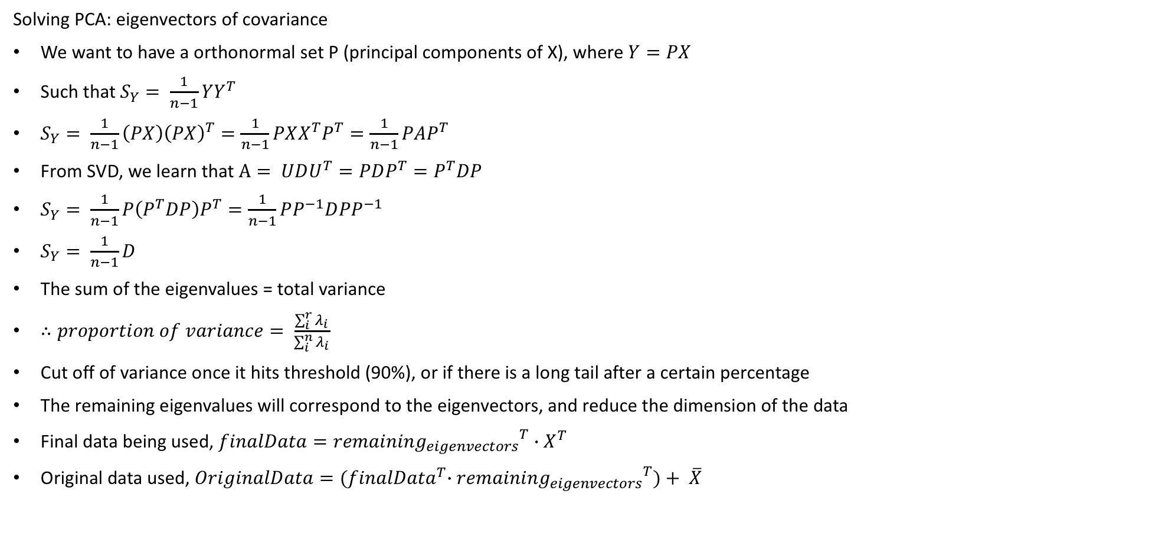
Principal Component Analysis
Solving PCA: eigenvectors of covariance
We want to have a orthonormal set P (principal components of X), where $Y=PX$
Such that $S_{Y}= \frac{1}{n−1}YY^{T}$
$S_{Y}= \frac{1}{n−1}\left(PX\right){\left(PX\right)}^{T}=\frac{1}{n−1}PXX^{T}P^{T}=\frac{1}{n−1}PAP^{T}$
From SVD, we learn that $A= UDU^{T}=PDP^{T}=P^{T}DP$
$S_{Y}= \frac{1}{n−1}P\left(P^{T}DP\right)P^{T}=\frac{1}{n−1}PP^{−1}D{PP}^{−1}$
$S_{Y}= \frac{1}{n−1}D$
The sum of the eigenvalues = total variance
$∴proportion of variance= \frac{\sum_{i}^{r}{λ_{i}}}{\sum_{i}^{n}{λ_{i}}}$
Cut off of variance once it hits threshold (90%), or if there is a long tail after a certain percentage
The remaining eigenvalues will correspond to the eigenvectors, and reduce the dimension of the data
Final data being used, $finalData={remaining_{eigenvectors}}^{T}∙X^{T}$
Original data used, $OriginalData={(finalData}^{T}{∙remaining_{eigenvectors}}^{T})+ \overline{X}$

Slide 27
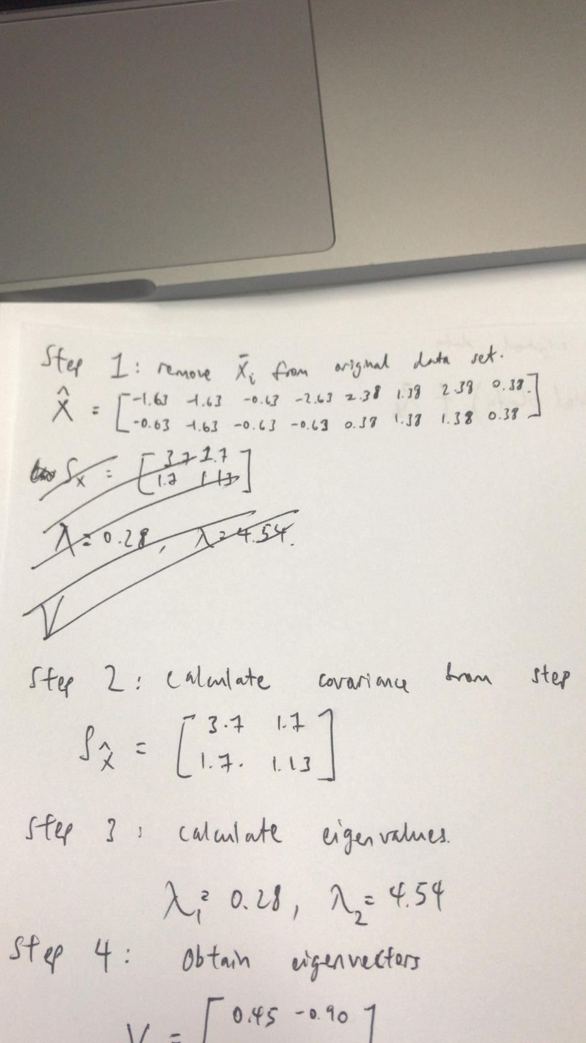
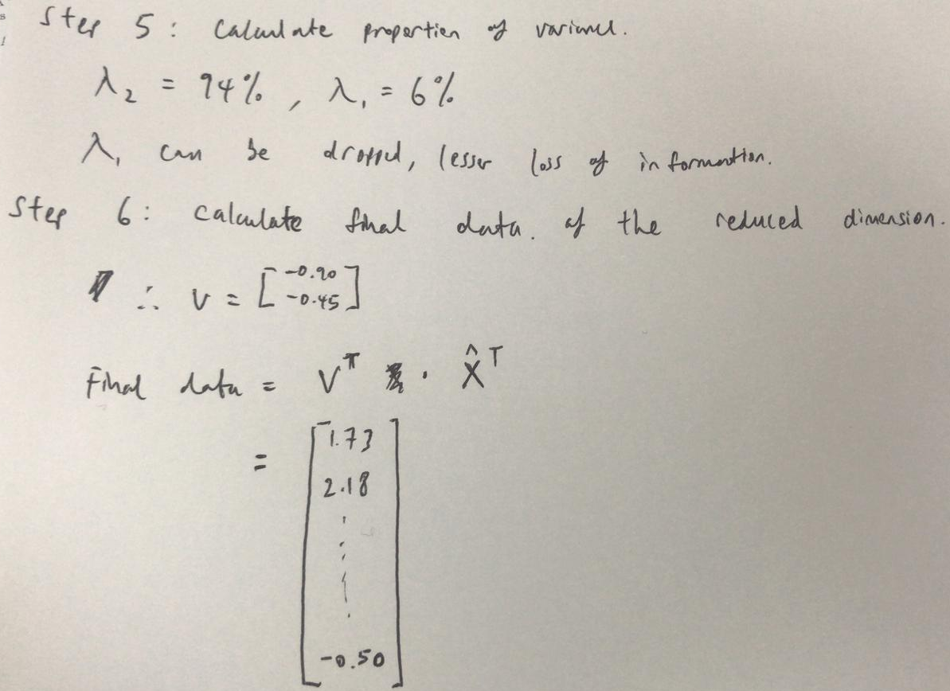
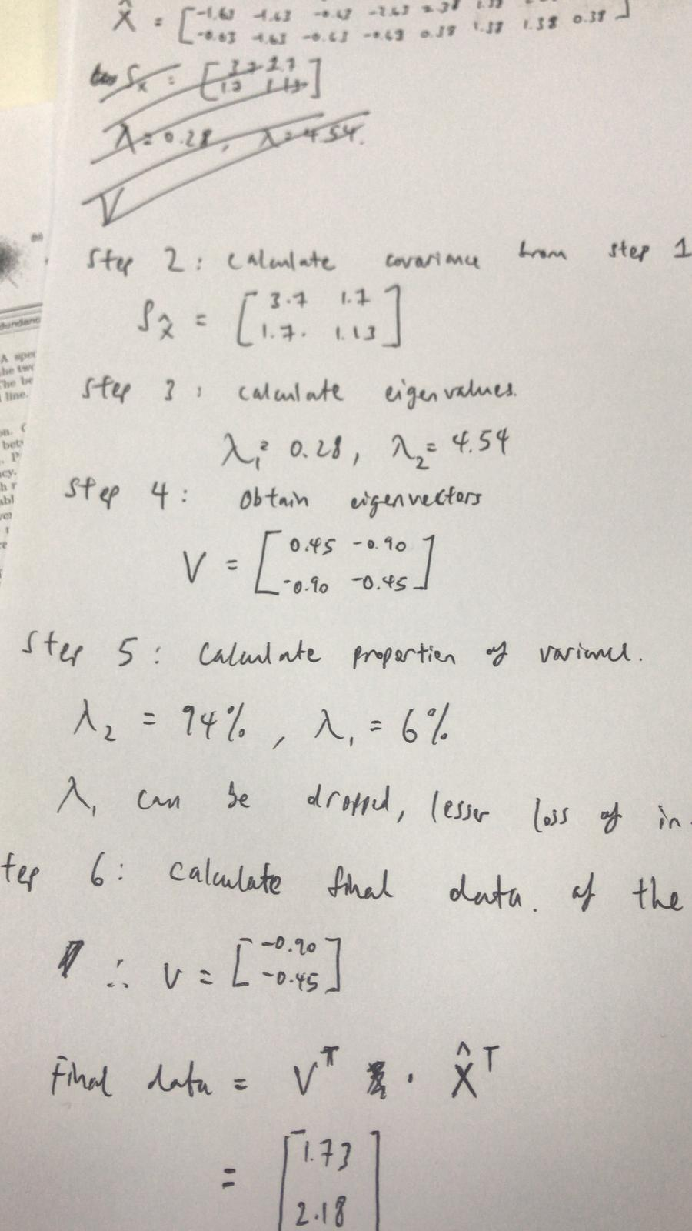
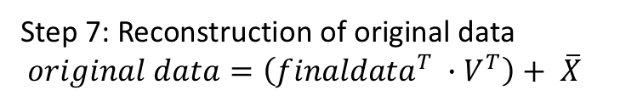
Principal Component Analysis
Example:
x1 | 1 | 1 | 2 | 0 | 5 | 4 | 5 | 3
x2 | 3 | 2 | 3 | 3 | 4 | 5 | 5 | 4
Step 7: Reconstruction of original data
$original data=\left({finaldata}^{T} ∙V^{T}\right)+ \overline{X}$

Slide 28
Principal Component Analysis
Example:
Notice how PCA doesn’t change the underlying data but instead compress the original data to use 1 component (instead of 2)
The final data will be the reduced dimension, and it will be used as the dataset for training data (of regression or classification)

Slide 29
Matrix Factorization
QR decomposition
LU decomposition

Slide 30
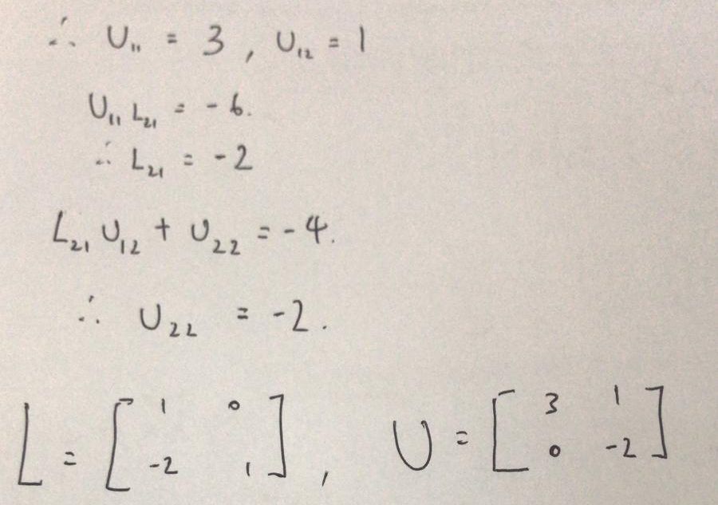
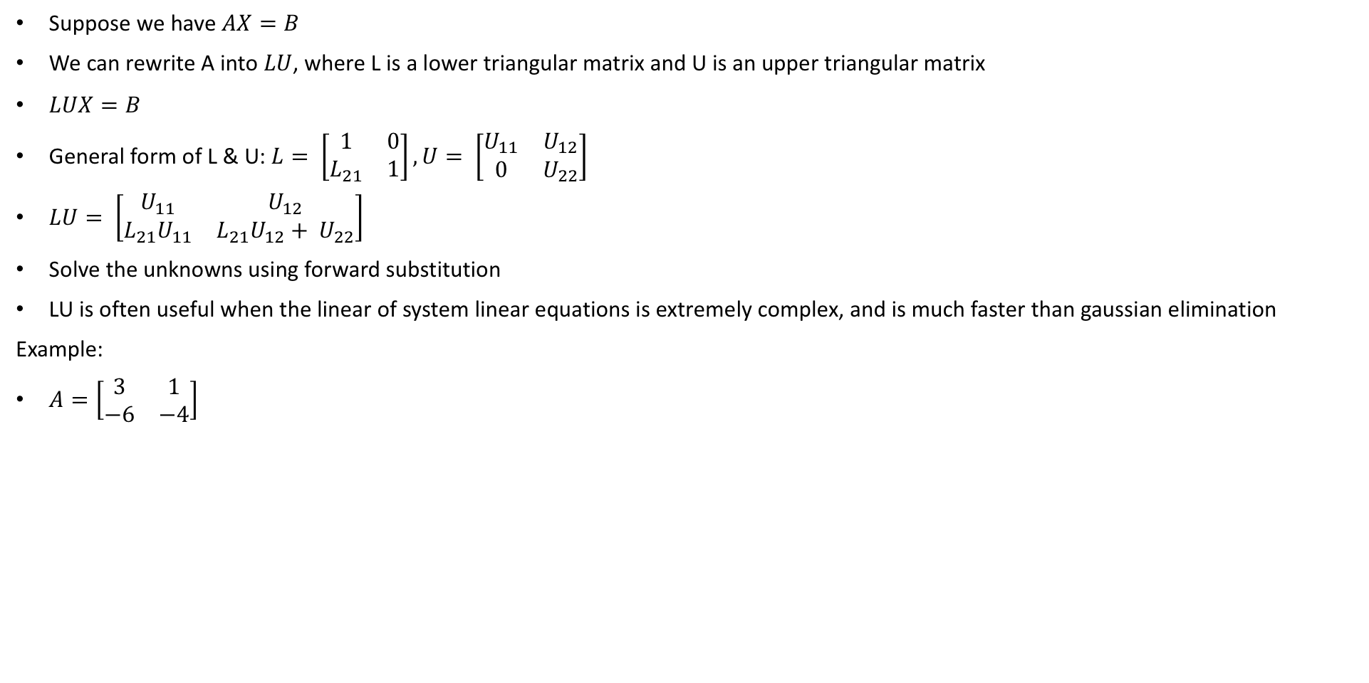
LU Decomposition
Suppose we have $AX=B$
We can rewrite A into $LU$, where L is a lower triangular matrix and U is an upper triangular matrix
$LUX=B$
General form of L & U: $L= \left[\begin{matrix}1 & 0 \\ L_{21} & 1\end{matrix}\right],U= \left[\begin{matrix}U_{11} & U_{12} \\ 0 & U_{22}\end{matrix}\right]$
$LU= \left[\begin{matrix}U_{11} & U_{12} \\ L_{21}U_{11} & {L_{21}U_{12}+ U}_{22}\end{matrix}\right]$
Solve the unknowns using forward substitution
LU is often useful when the linear of system linear equations is extremely complex, and is much faster than gaussian elimination
Example:
$A=\left[\begin{matrix}3 & 1 \\ −6 & −4\end{matrix}\right]$

Slide 31
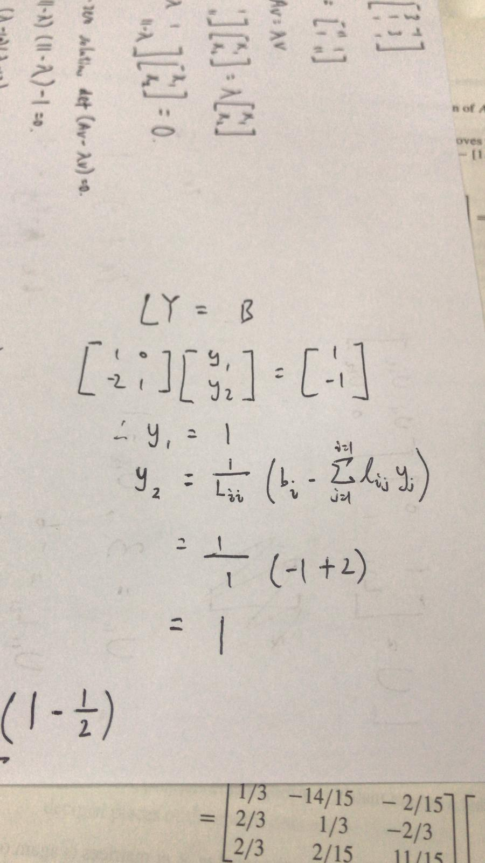
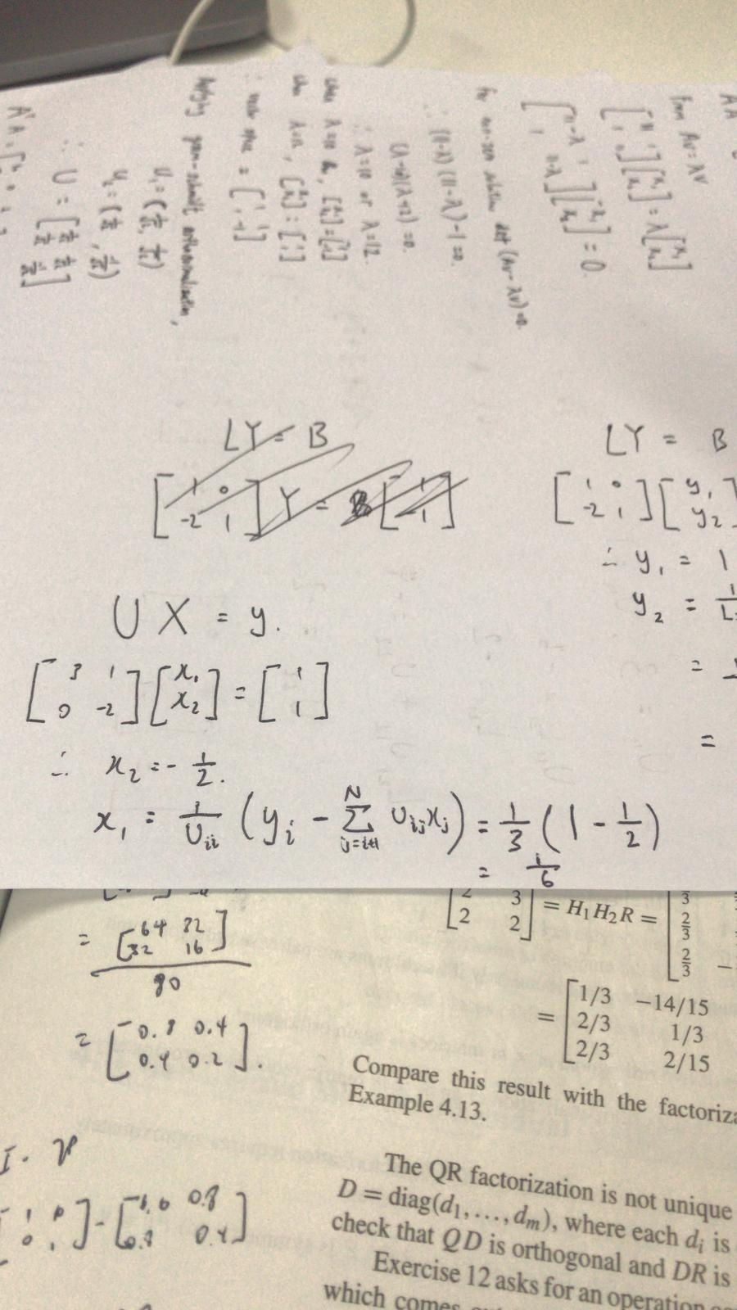
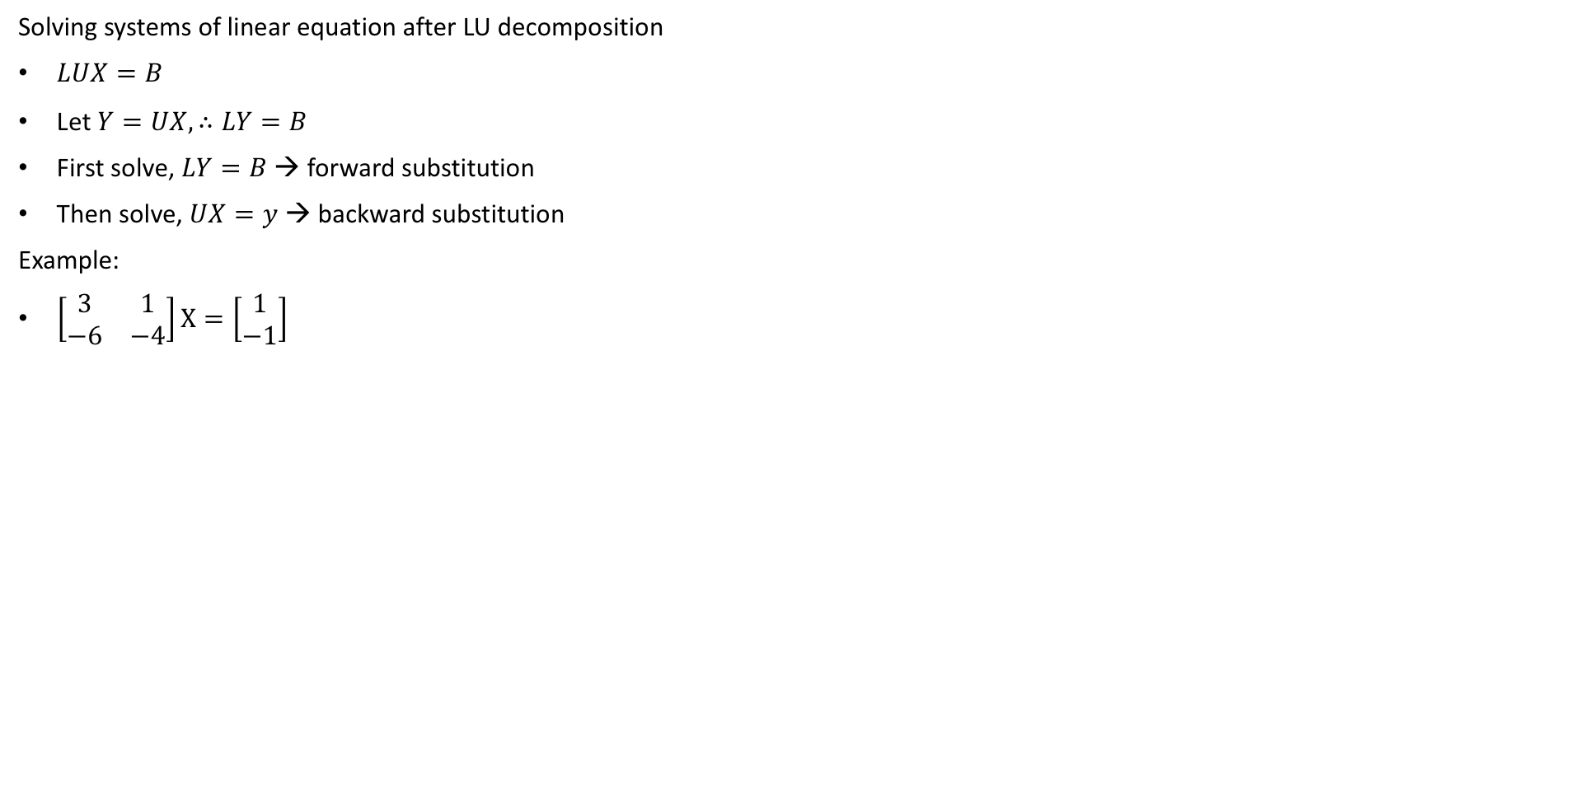
LU Decomposition
Solving systems of linear equation after LU decomposition
$LUX=B$
Let $Y=UX, ∴LY=B$
First solve, $LY=B$ → forward substitution
Then solve, $UX=y$ → backward substitution
Example:
$\left[\begin{matrix}3 & 1 \\ −6 & −4\end{matrix}\right]X=\left[\begin{matrix}1 \\ −1\end{matrix}\right]$

